Slide 1

Customers, Orders and Transactions – A SQL Based
Data Analysis Project
By: Viishhnu Vardhun Reddy

Slide 2

Introduction
Due to rapid advancements in technology and digital infrastructure, the usage of online platforms like Amazon, Flipkart, and other e-commerce applications has significantly increased. With more people opting to purchase products online, the volume of raw data related to customers, orders, and transactions is growing exponentially.
To derive meaningful insights from this large volume of data, it's essential to perform structured data analysis. Analyzing patterns in transactions, customer behavior, and product demand helps businesses improve user experience, reduce failures, and make informed decisions.
Why this project
Data is the New Oil
SQL in Action
Objectives
Businesses generate immense amounts of customer, order, and transaction data. Understanding this data is key to improving services and profits.
Apply SQL concepts like joins, subqueries, and aggregations to solve real-world business questions and practice data-driven decision-making.
This project demonstrates how SQL can handle relational data, perform advanced queries, and uncover meaningful patterns.

Slide 3
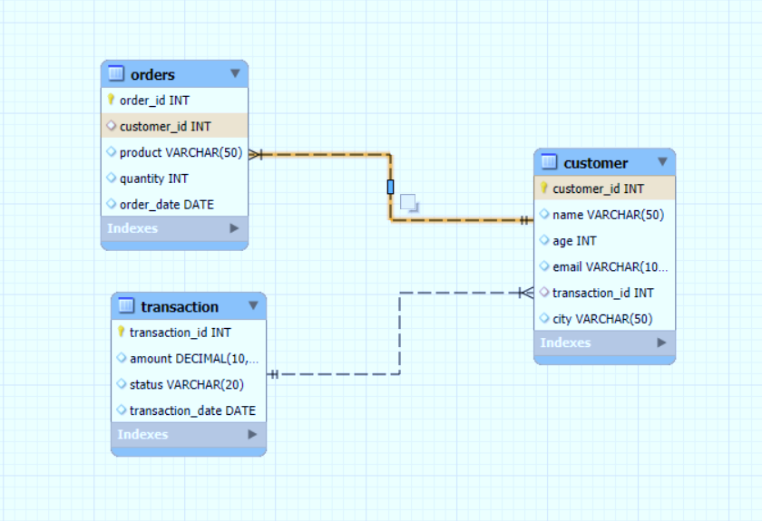
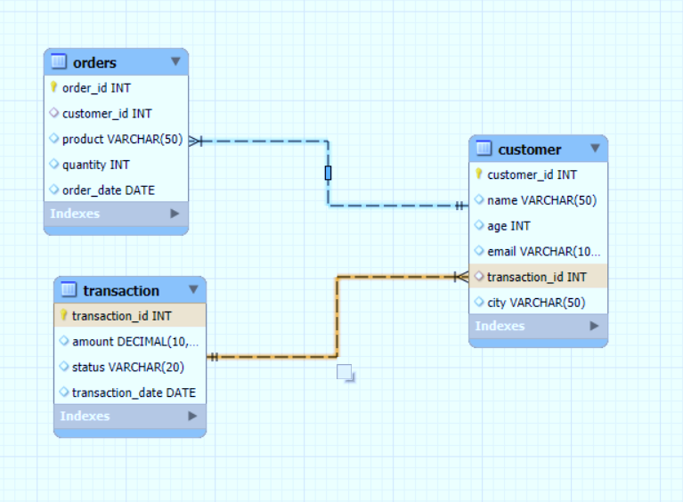
ER - DIAGRAMS

Slide 4
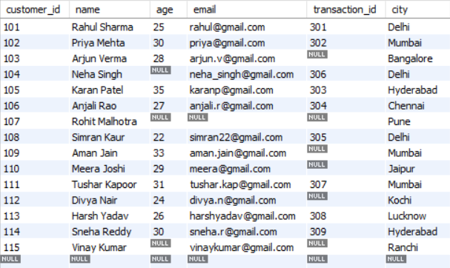
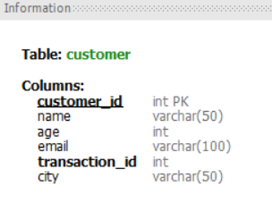
TABLES
CUSTOMER

Slide 5
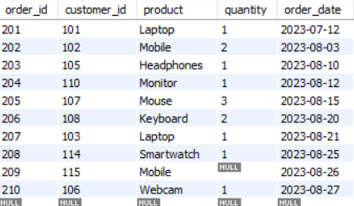
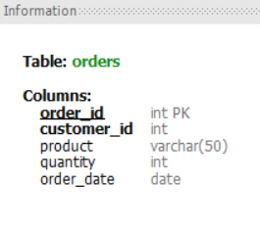
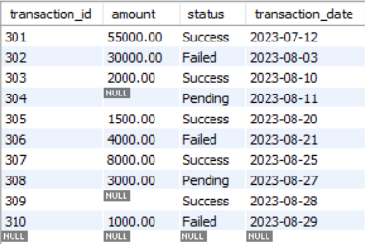
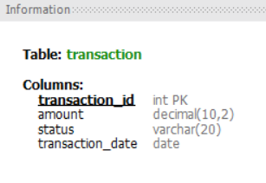
ORDERS
TRANSACTION

Slide 6
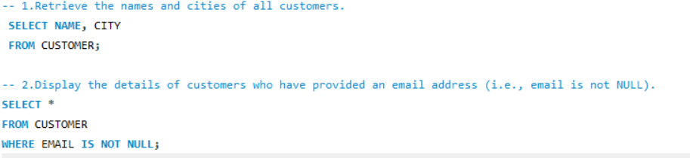
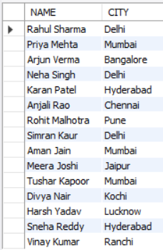
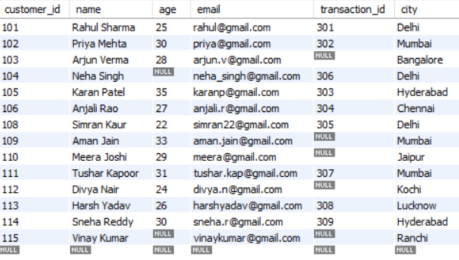
Getting Insights from Tables

Slide 7
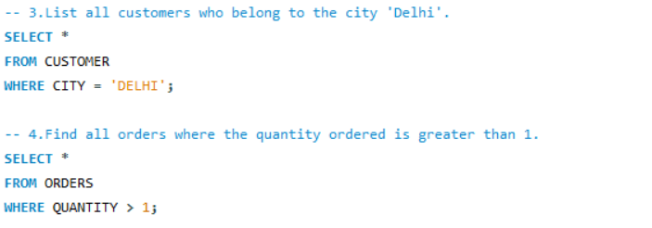
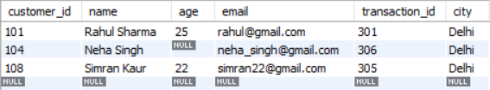
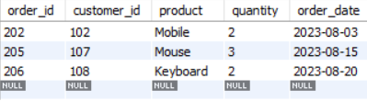

Slide 8
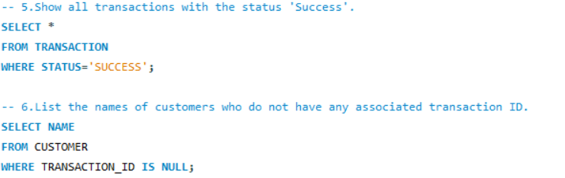
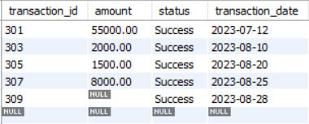
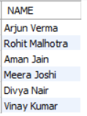

Slide 9
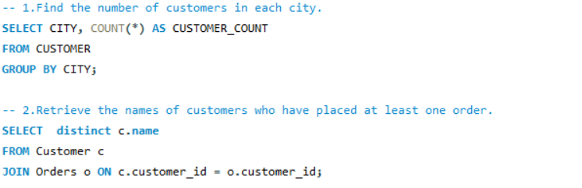
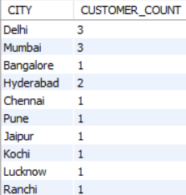
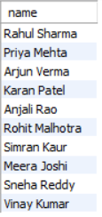

Slide 10
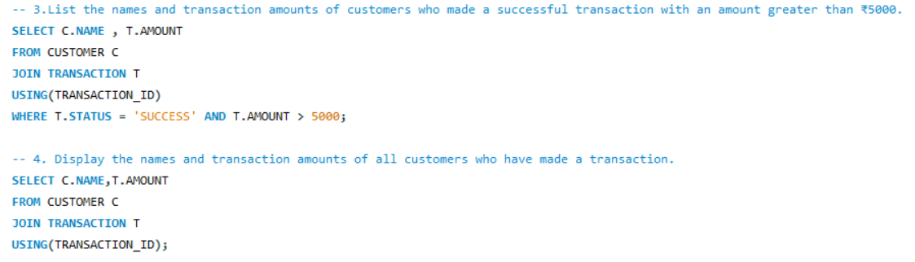
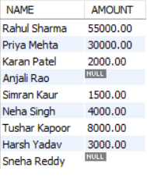
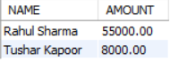
Here null represents they made transaction but it is failed

Slide 11
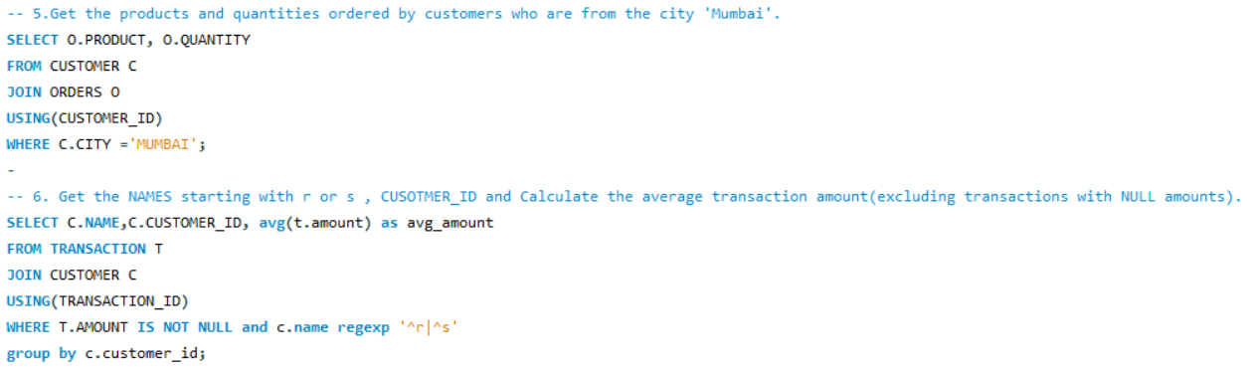
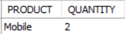
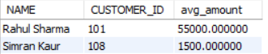
REGEXP is used to search for patterns in strings—more powerful than LIKE.

Slide 12
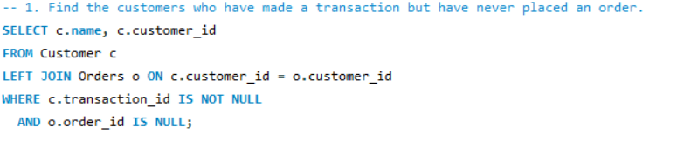
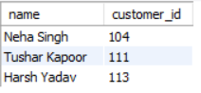

Slide 13
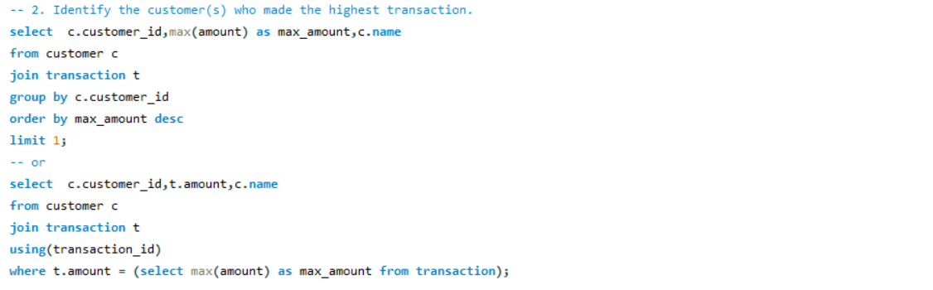
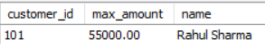

Slide 14
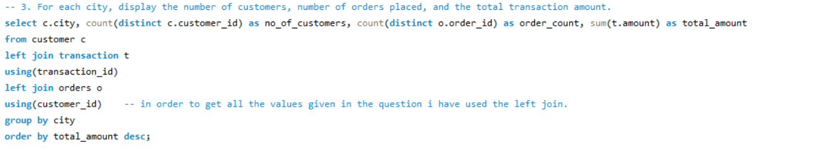
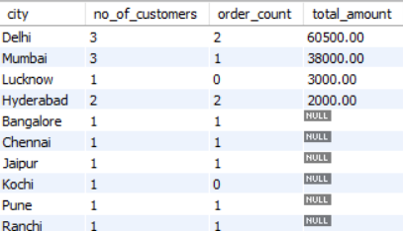

Slide 15
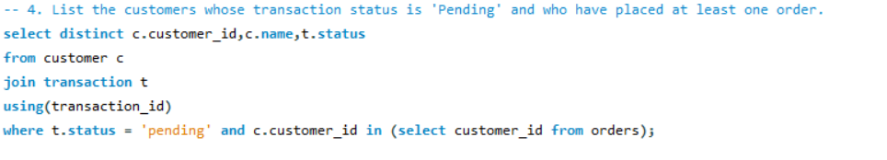
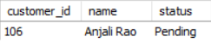

Slide 16
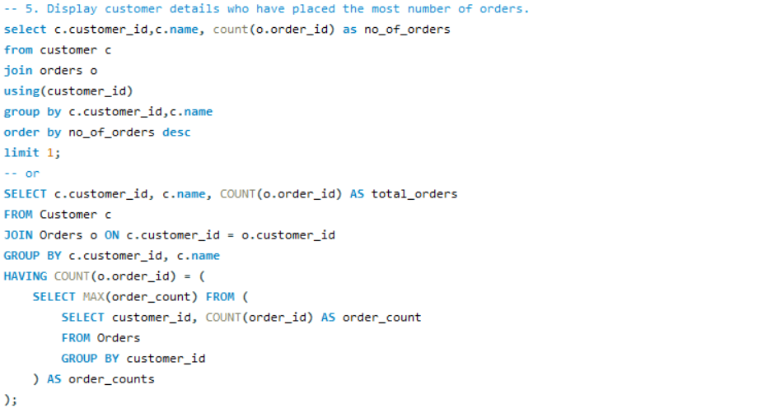
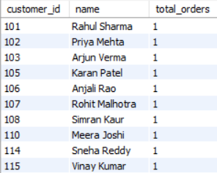

Slide 17
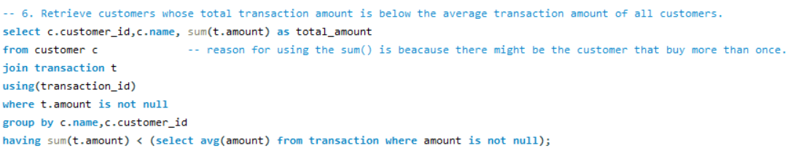
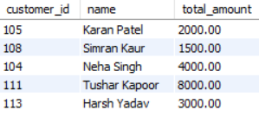

Slide 18
Conclusion

Slide 19


